Slide 1
Master Data Visualization with Seaborn in Just 3 Minutes！👀

Slide 2


What’s seaborn？
A powerful Python library
For data visualization
Simplifies the process of creating statistical graphics📈
Built on top of Matplotlib

Slide 3
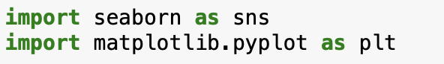
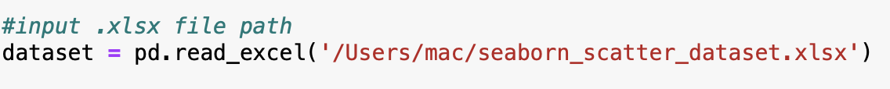
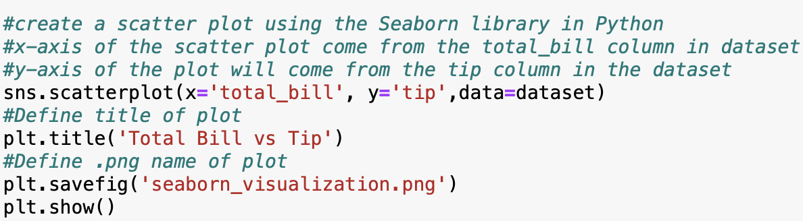
Let’s quickly experience it!
First step: Import library
Second step: Import dataset
Third step: Define graph

Slide 4
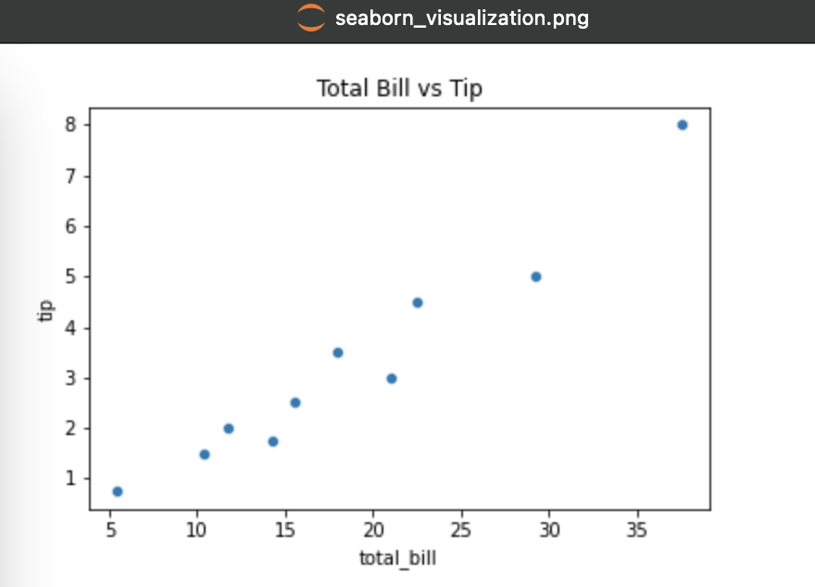
Final Result!
Get the graph in a .png file,
which is saved in the same path with your python code file!

